Slide 1
ASAIC OVERVIEW
April 30, 2014
Saab Sensis Corporation

Slide 2
Introduction
Saab Sensis has surface and terminal data expertise
  Prime contractor for ASDE-X, ASSC & RWSL systems
  Numerous techniques to extract information
  Ability to improve accuracy
  Automated event detection tools and capabilities
Safety
  “Hot spot” identification to focus effort
  Anomalous behavior recognition and trending
  Unreported events made visible
Efficiency
  Fuel burn
  Environmental impact
  Economic savings
Analytical work
  Analysis
  Case studies
  Benefits studies

Slide 3
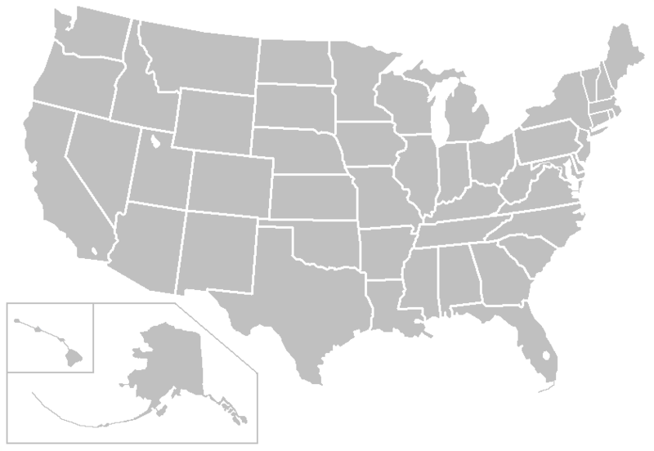
Saab Sensis ASDE-X/ASSC/RWSL Sites
SEA
PDX
BOS
PVD
BDL
JFK
LGA
EWR
PHL
BWI
DCA
IAD
MSP
MKE (ASDE-X Key Site)
DTW
SLC
ORD
PIT
MDW
CLE
SFO (ASSC Key Site)
DEN
MCI
STL
SDF
LAS
CVG
SNA
CLT
PHX
MEM
LAX
SAN
ATL
DFW
IAH
MSY
HNL
HOU
MCO (RWSL Key Site)
Key
ASDE-X (13)
ASDE-X & RWSL (22)
ASSC (8)
ASSC & RWSL (1)
FLL
ANC
MIA
Saab Sensis is the expert in airport surface surveillance

Slide 4
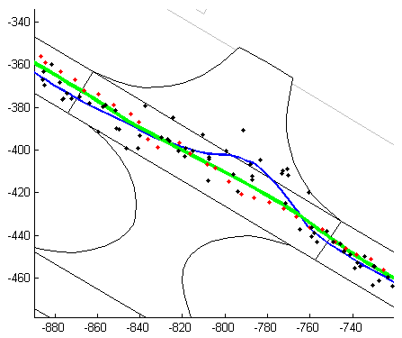
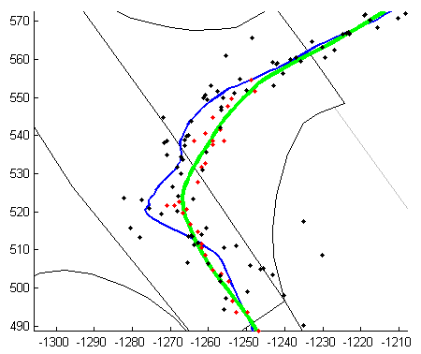
Track Joining and Smoothing
BLACK: MLAT Position Data
RED: SMR Position Data
BLUE: Track Reconstruction (Ver. 3)
GREEN: Track Reconstruction (Ver. 4)
Post processing yields more accurate position estimates

Slide 5

Metrics and Measurements
  Saab Sensis has developed algorithms to convert ASDE-X data into information.
  We create continuous tracks from the airport surface out to approximately 60 nautical miles from system center.
  Saab Sensis have processed over 15,000 days at the 35 ASDE-X airports.
  Examples of the type of information Saab Sensis can extract from the ASDE-X includes:
Taxi times
Duration and location of surface delays
Ramp and runway usage
Arrival/departure rates
Ground vehicles tracks
Vehicle velocity and acceleration
Vehicle heading and orientation
Routes used
Wheels up/wheels down
Anomalous events
Many other metrics….
Saab Sensis has created a reliable system to process surveillance data

Slide 6
Automated Anomaly Detection and Scoring
Sudden stop
Irregular turn
“Missed” departures
“Missed” arrivals
Wake vortex
Runway incursion
Conflict risk
Route excursion
Runway transition
Long taxi times

Slide 7
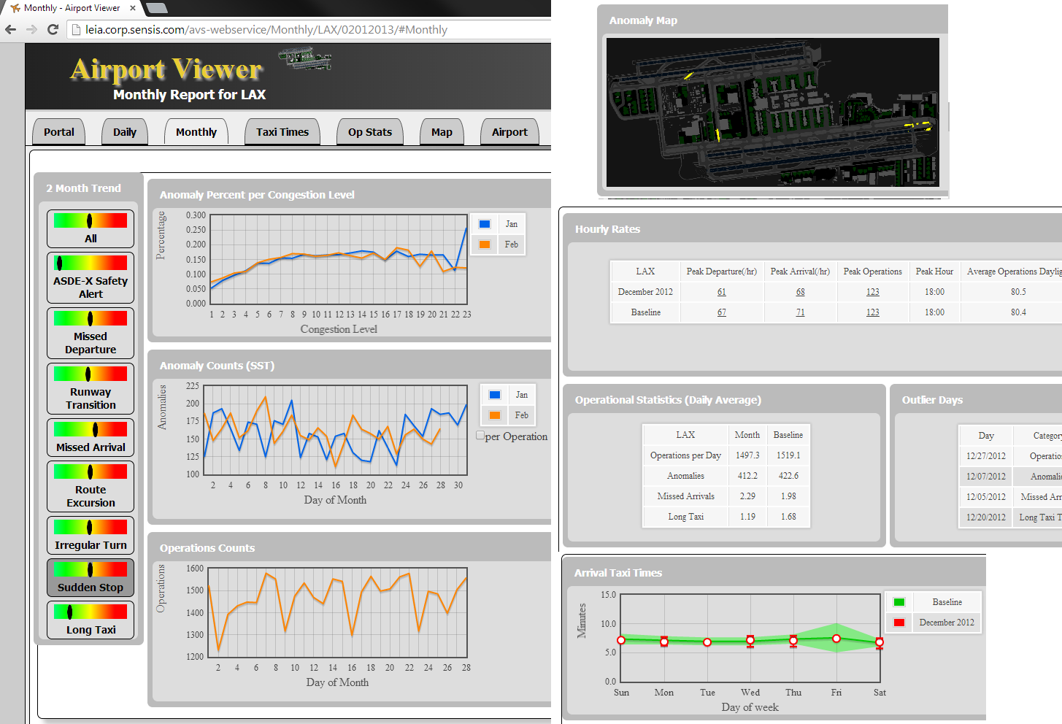
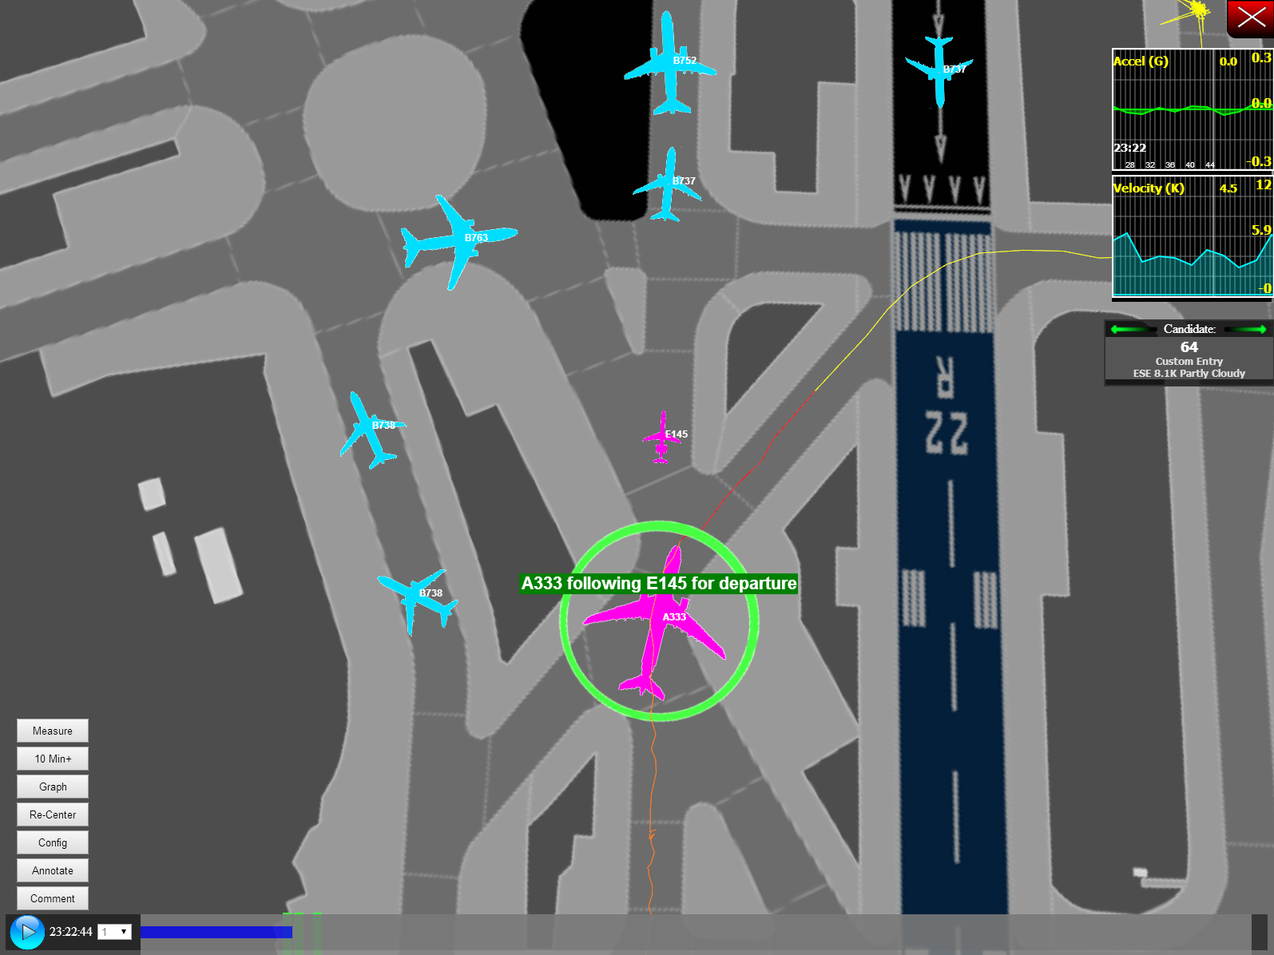
The Viewer
Saab Sensis has constructed a processing/playback/analysis tool.

Slide 8
Study: ATL Arrival Surface Delays During 2010
  Total arrivals: 351,210 arrivals
  A hold is any stoppage by an aircraft in the movement area which lasts more than 10 seconds:
  Total number of holds: 313,955 holds
  Average number holds per arrival: 0.67
  Typical hold time (mode): 1.75 minutes
  Total time spent in holds during 2010: 381 days
  Cost due to holds ($35/min): $19.2 million dollars
  A “long” hold is any hold greater than 10 minutes. A long hold is typical due to the unavailability of a gate or the ramp entrance being blocked:
  Total number of long holds: 5,477 holds
  Total time spent in long holds: 60 days
  Cost due to long holds ($35/min): $3 million dollars
Analyses can identify potential efficiency improvements

Slide 9
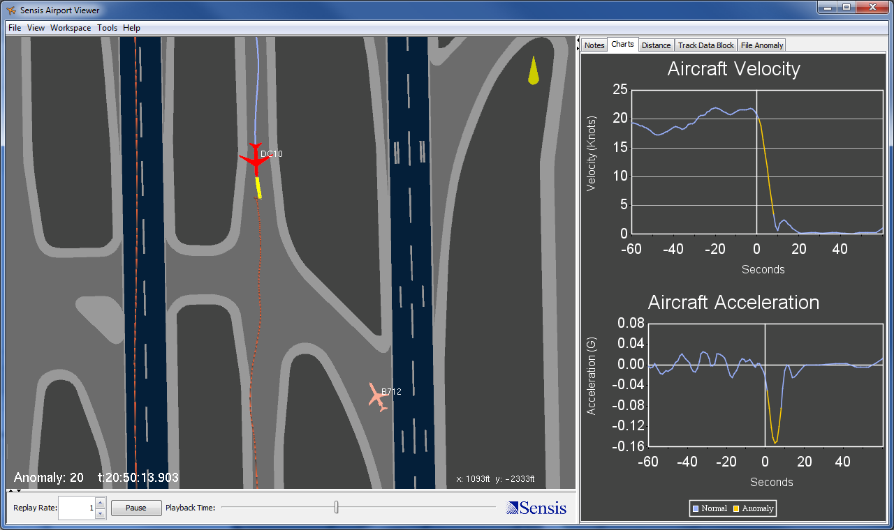
Example: Automated Determination of Anomalous Events (Sudden Stops)
Sudden Stop
Automated detection of anomalous events
Notes:
Irregular Turn Set 1 Example 1

Slide 10
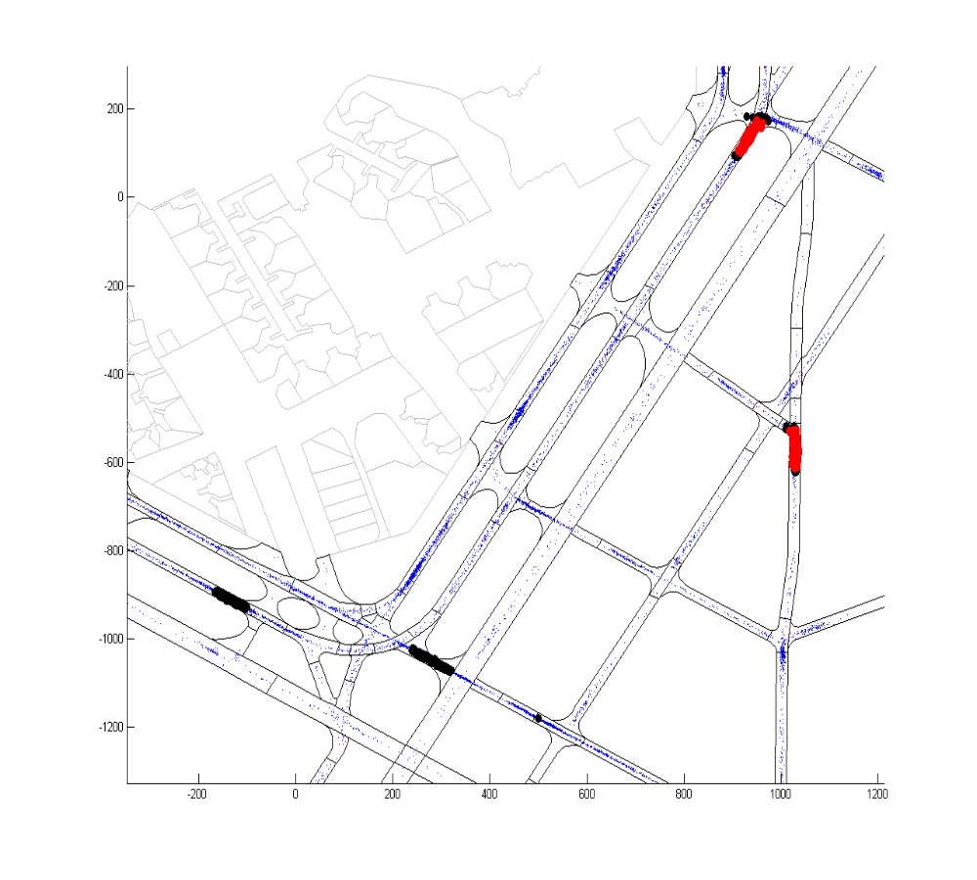
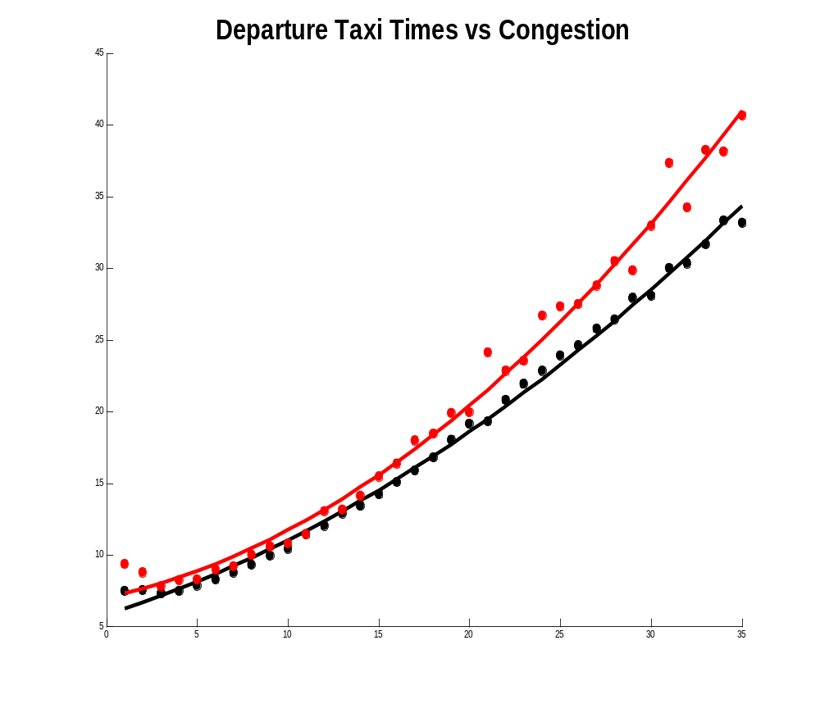
Study: Sudden Stop Impact
Each dot represents the location of a hard braking event during 2009.
Departures with sudden stop anomalies
Taxi Time (minutes)
Elevated sudden stop clustering
1 StD above mean
Major clustering
2 StD above mean
Non-anomalous departures
Study period: 2010
Study airport: JFK
Congestion
Analysis identifies potential safety and efficiency improvements

Slide 11
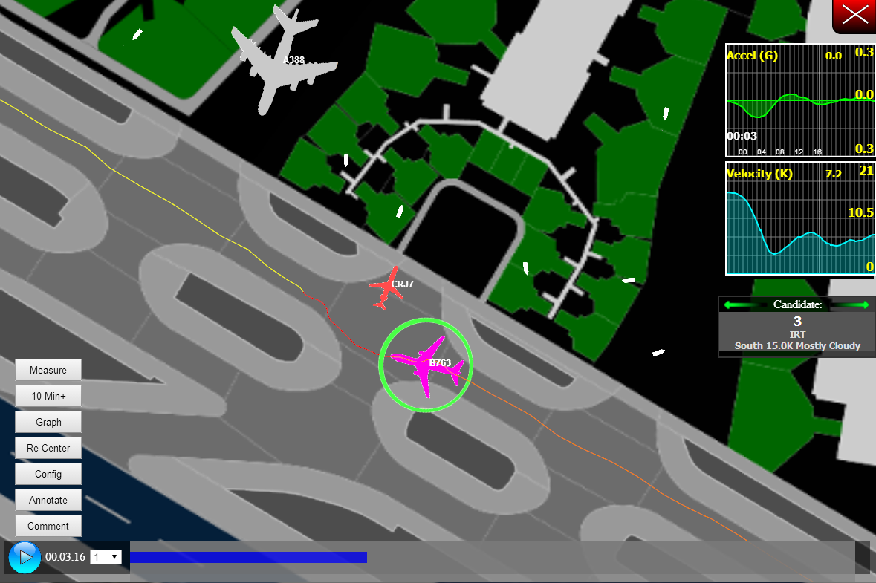
Example: Finding Associated Anomalies
Irregular Turn
Sudden Stop
Automated detection of coupled anomalous events
Notes:
Irregular Turn Set 1 Example 1

Slide 12
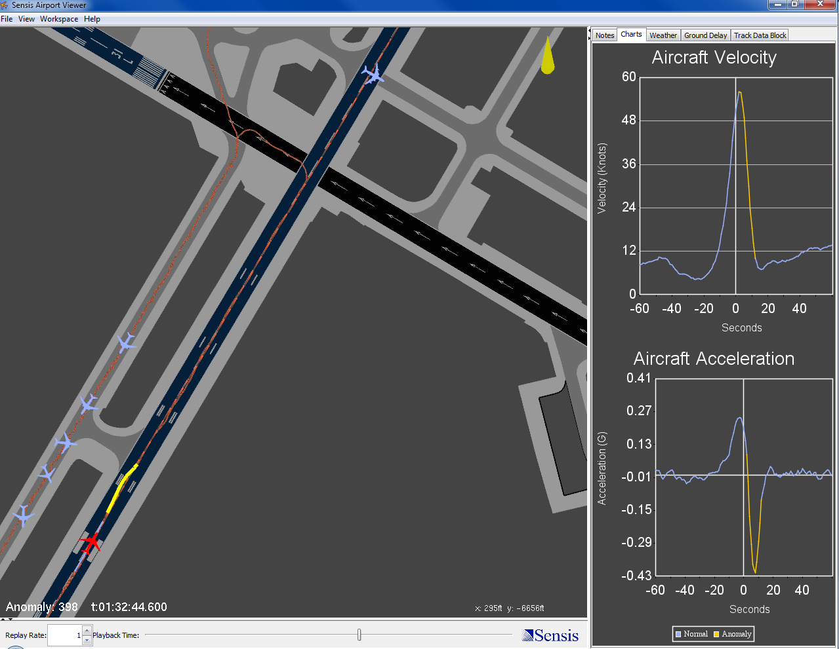
Example: “Missed” Departure
Taxiing aircraft
High acceleration rejection
Departing aircraft
Automated detection of anomalous events and causality

Slide 13
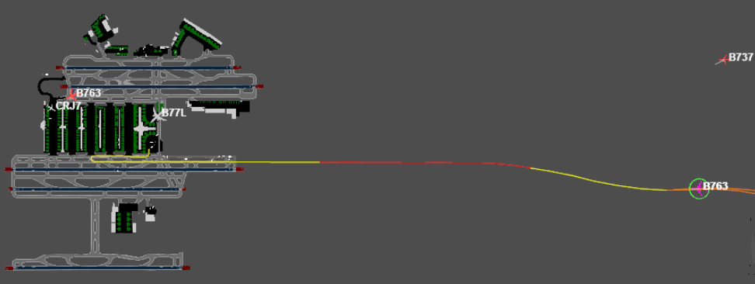
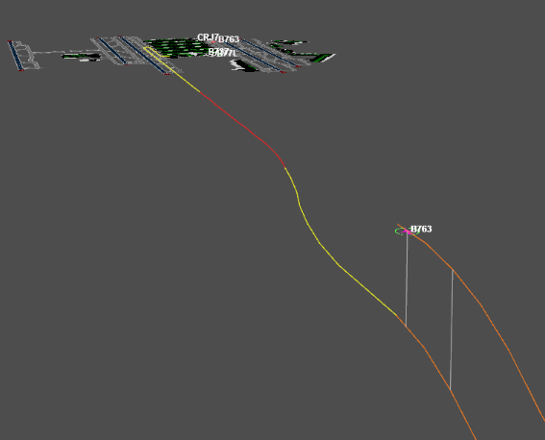
Study: “Missed Arrival” ATL Taxiway Landing
Lined up on 27L
Lands on taxiway
Given clearance to switch to 27R
Detected as “missed” arrival since the aircraft lined up for arrival but never used a runway
3D view
Automated detection of unstable approaches

Slide 14
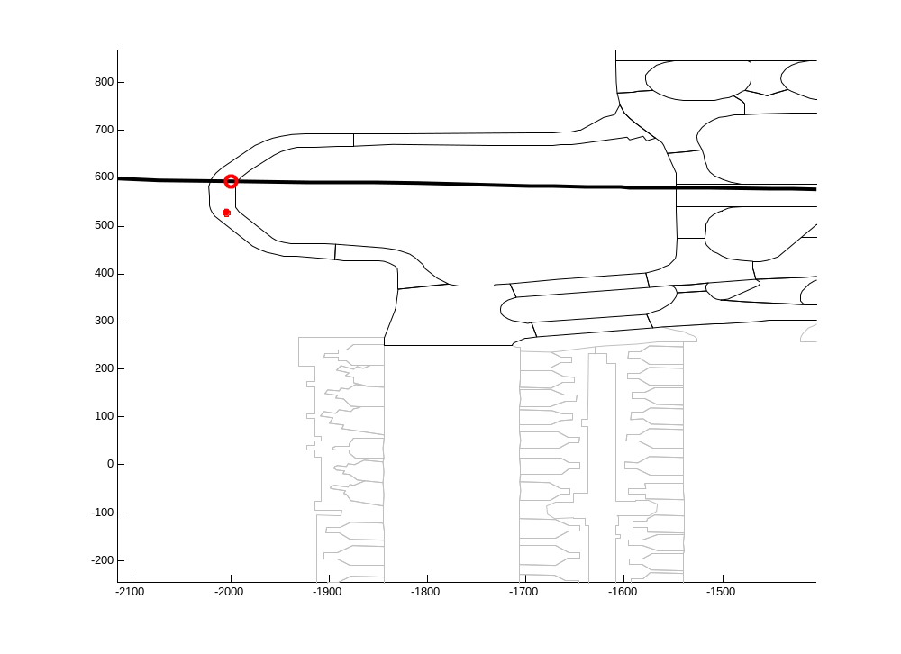
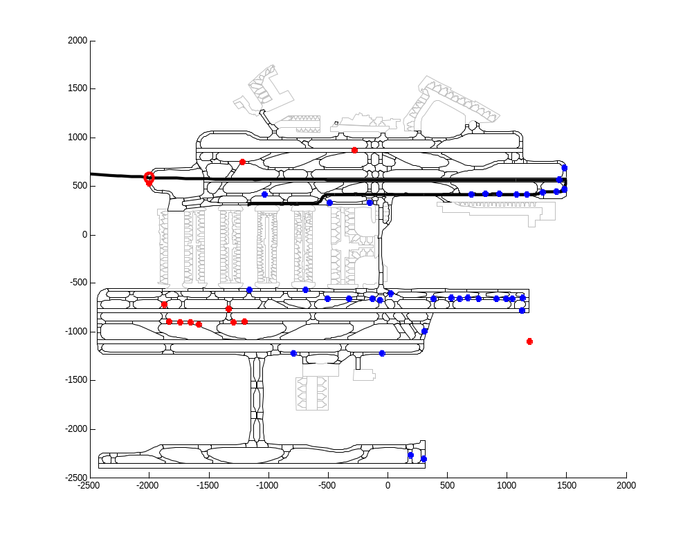
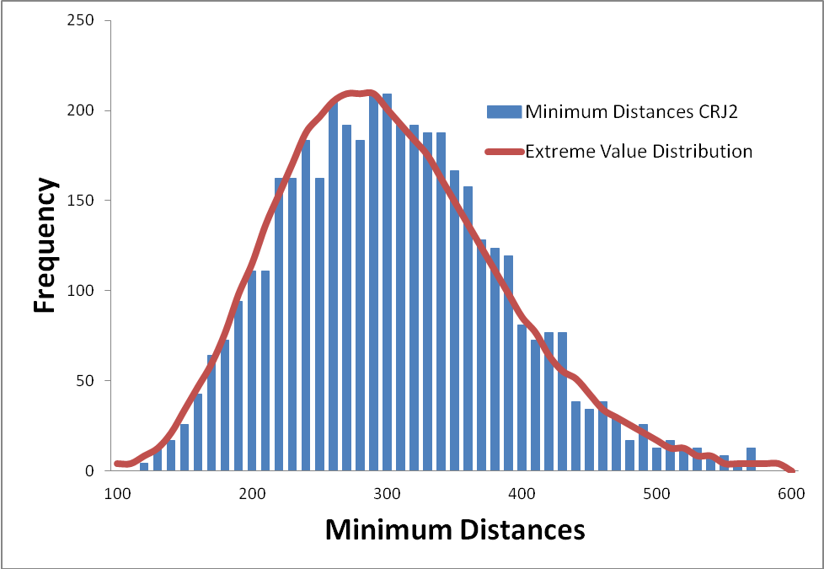
ATL End-Around Study (CRJ2 departures only)
From surveillance compute the minimum distance between every arrival-departure pair.
Departure reaches Victor
262 meter separation
Distance (meters) | Probability
10 | 1.30E-10
20 | 6.20E-10
30 | 2.78E-09
40 | 1.14E-08
50 | 4.32E-08
Arrival taxiing on Victor
Use an Extreme Value Distribution to predict distance probabilities.

Slide 15
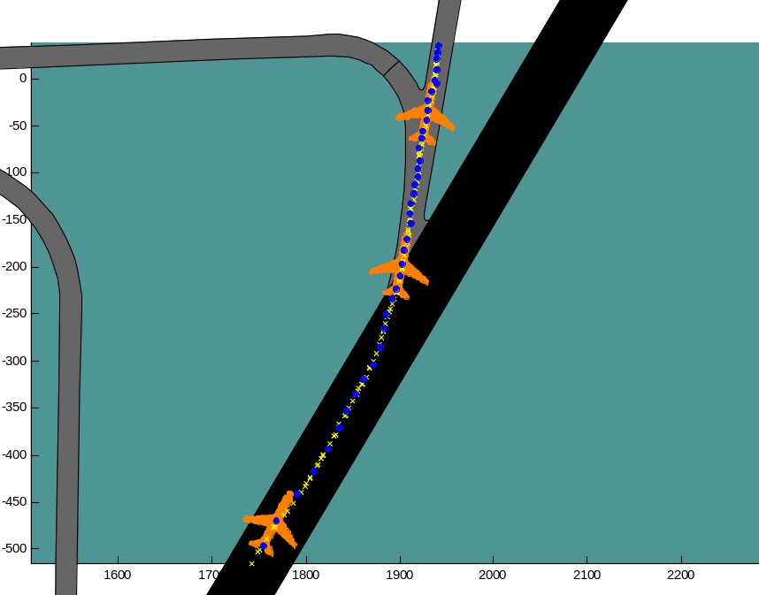
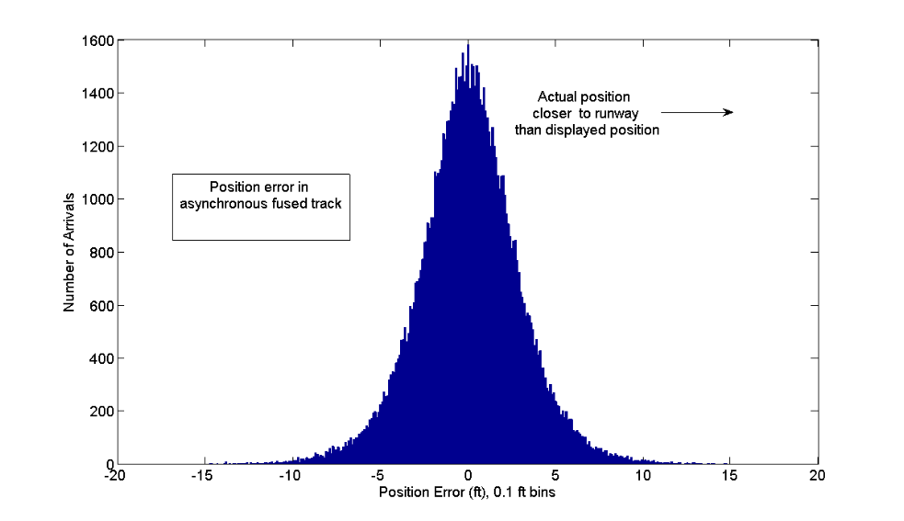
CONFIRMING RUNWAY EXIT STUDY
CONCLUSIONS:
ASDE-X could be used to confirm clearance of runway edge with confidence determined by the buffer distance.
Displayed icon size is biggest source of error.
Some of performance outliers are due to missing wake category information (use of “normal” icon for heavy).
ASDE-X data can also be used to quantify the predictability of aircraft movement from the runway edge to clearing any specified safety zone boundary.

Slide 16
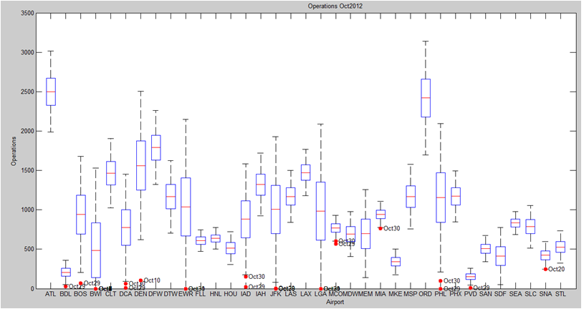
Operations Counts by Airport (October 2012)
Red dots are outliers for the month. October 29-30 is the date for hurricane Sandy
Secondary effects from hurricane Sandy at Orlando and Miami.
Mean daily operations counts for the 35 ASDE-X airports for October 2012. The mean is represented by the red line. The blue box represents 1 standard deviation and the dashed line is 3 standard deviations..

Slide 17
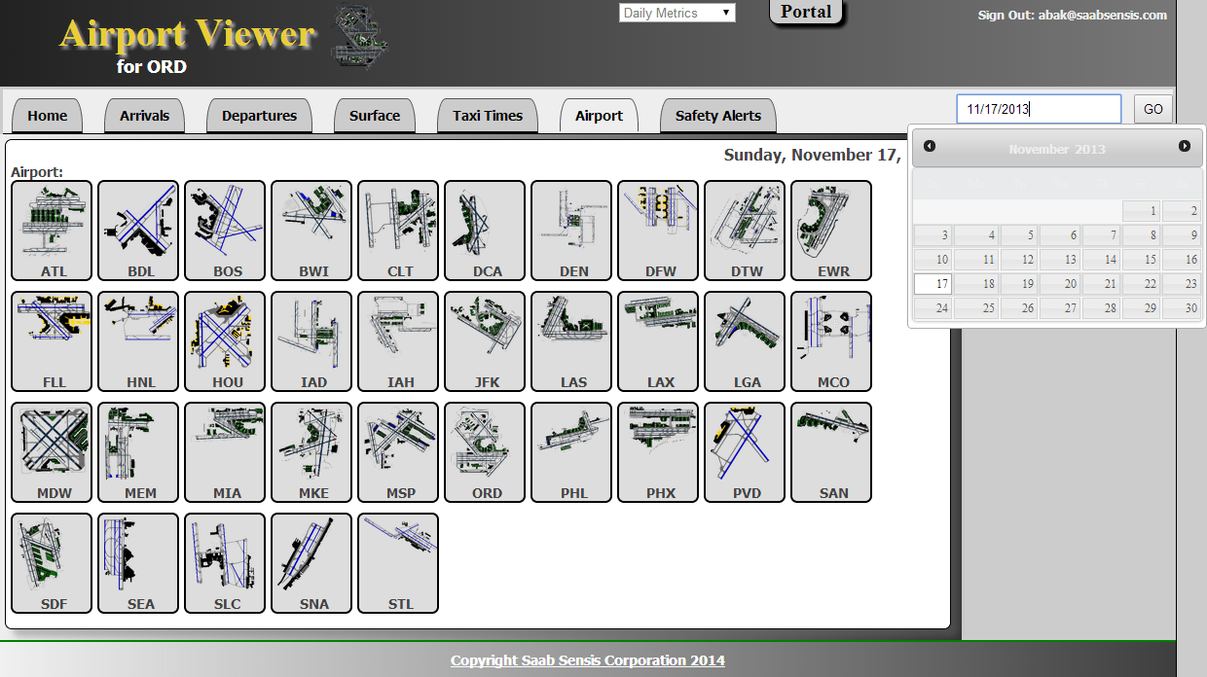
ASAIC- Airport Safety Anomaly Investigation Capability
35 Airports, 14+ Months Processed

Slide 18
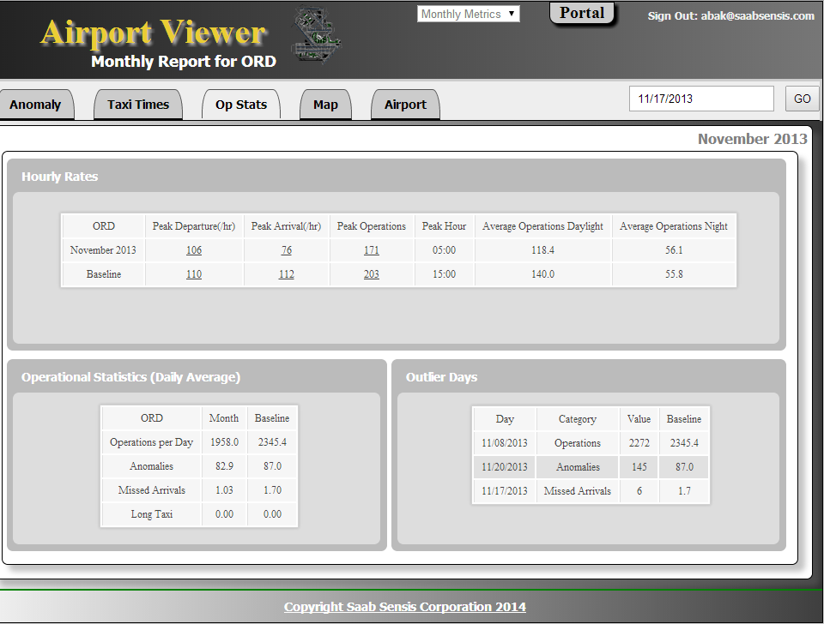
Operational Statistics
(Hourly and outlier metrics)
Playback the busiest
hour of the year
Identify abnormal
days

Slide 19
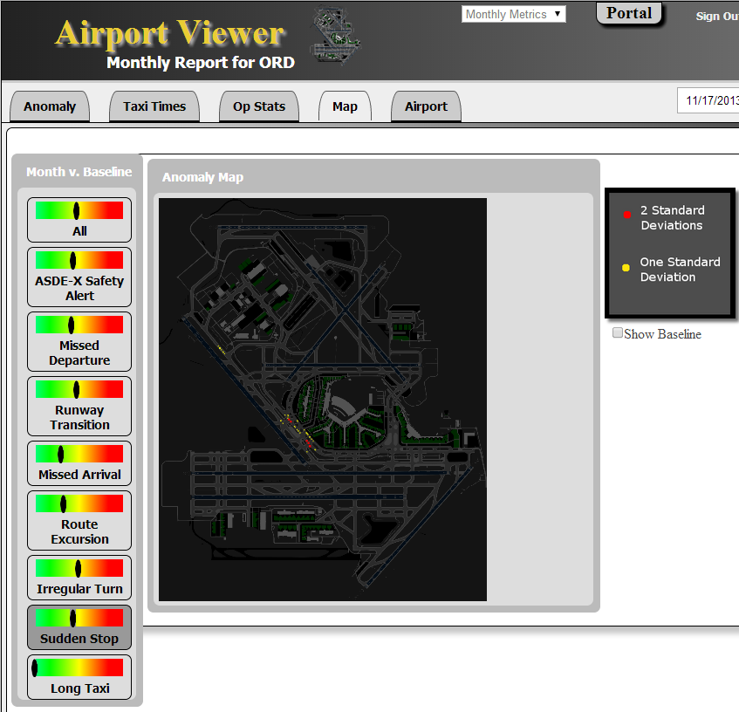
Monthly Anomaly Cluster Map
Shows locations on the airport surface where rates of anomaly candidates occur most often.

Slide 20
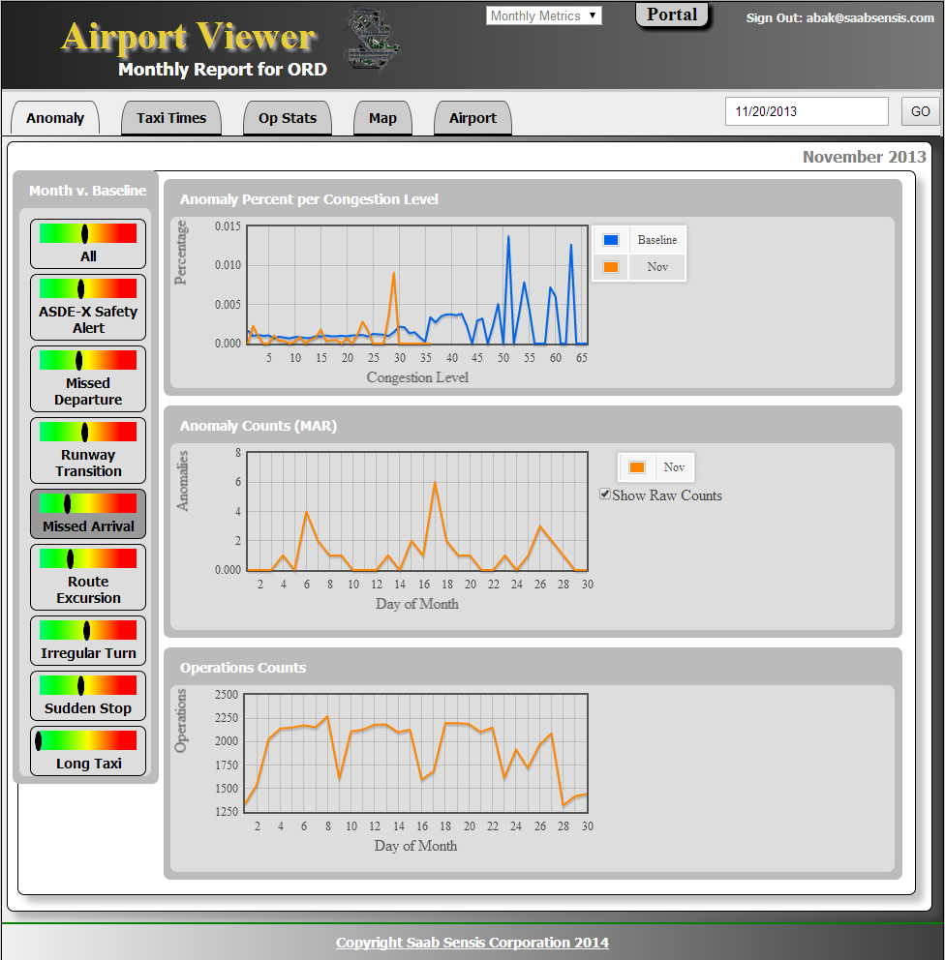
Monthly Metrics
Clickable Drilldown

Slide 21
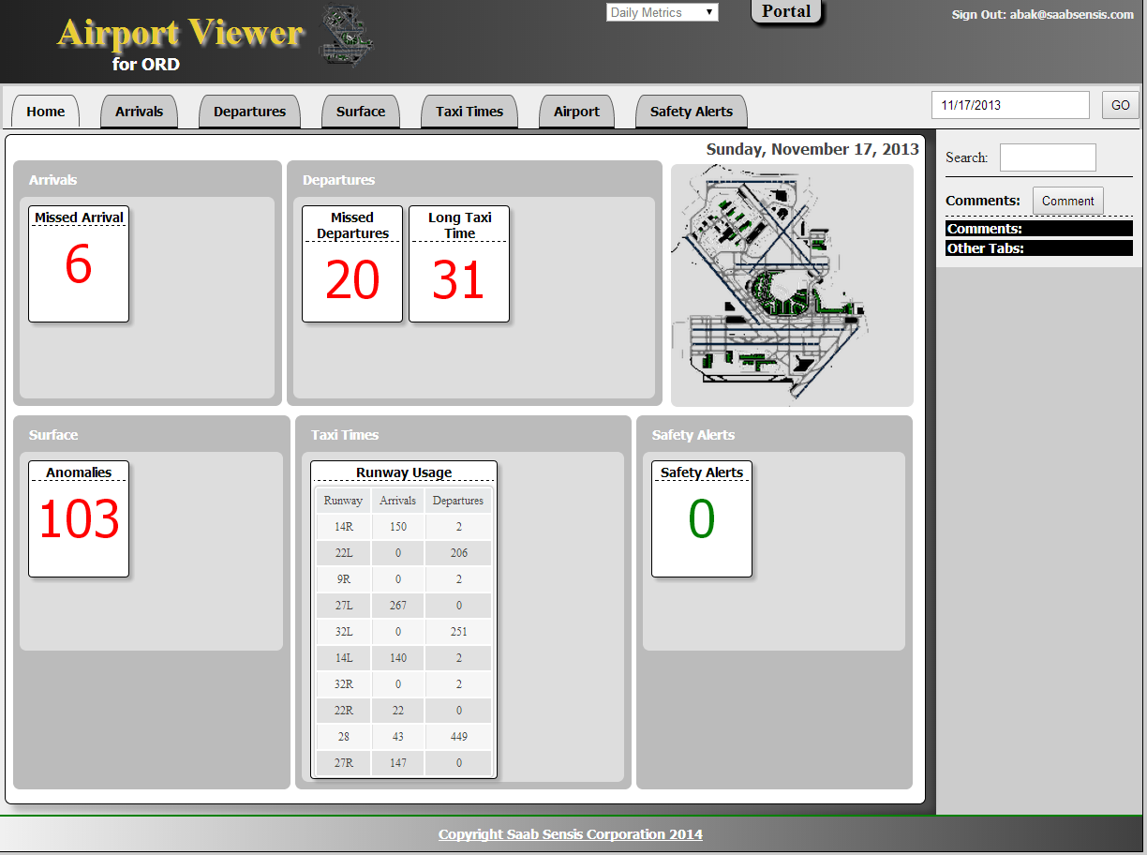
Daily Metrics

Slide 22
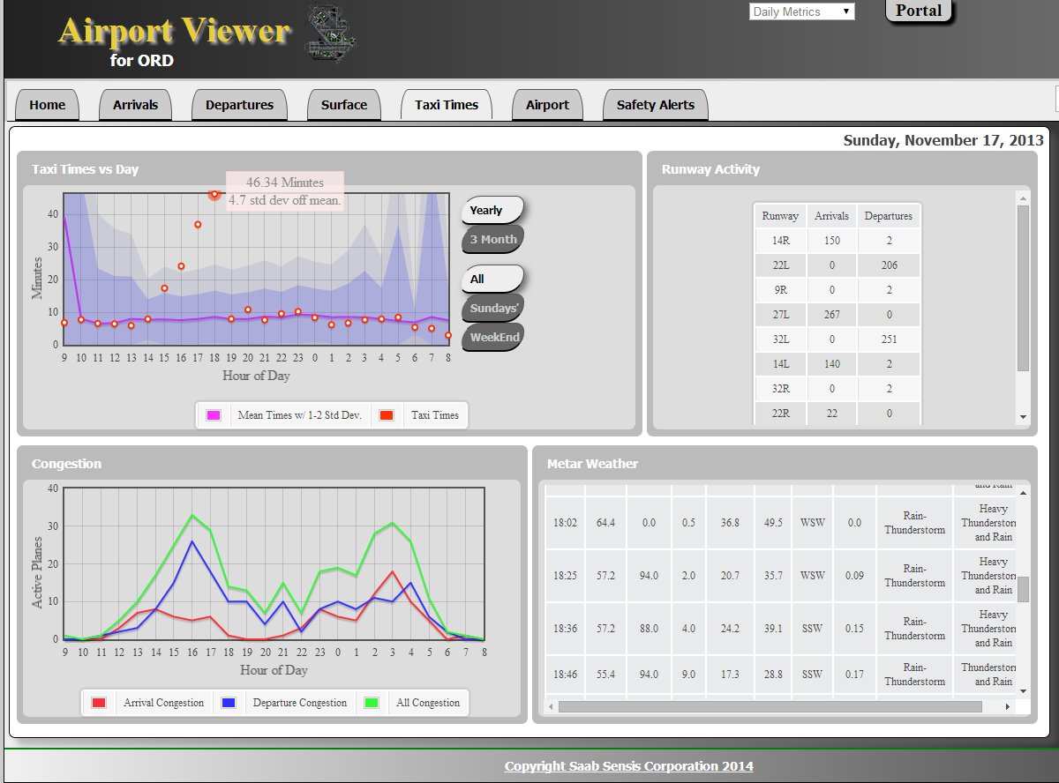
Taxi Times
Excessive taxi times due to heavy thunderstorms.

Slide 23
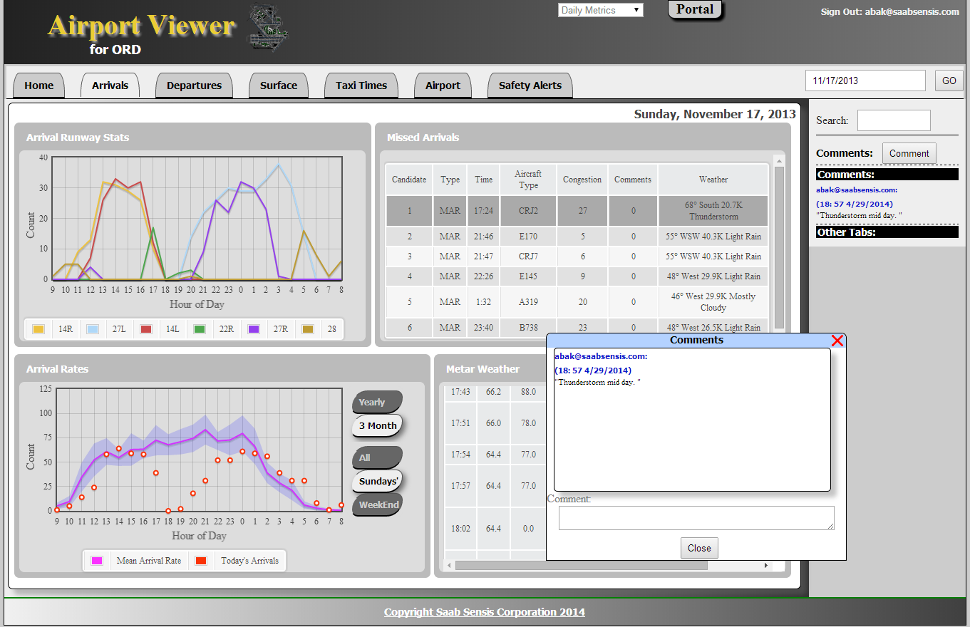
Missed Arrivals
Anomaly playback
Add user comments

Slide 24
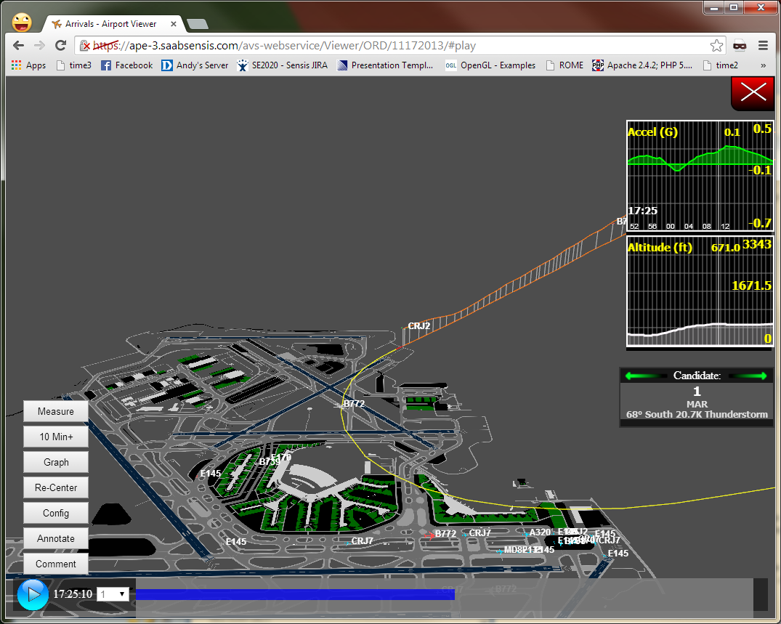
Video Playback of Anomalies

Slide 25
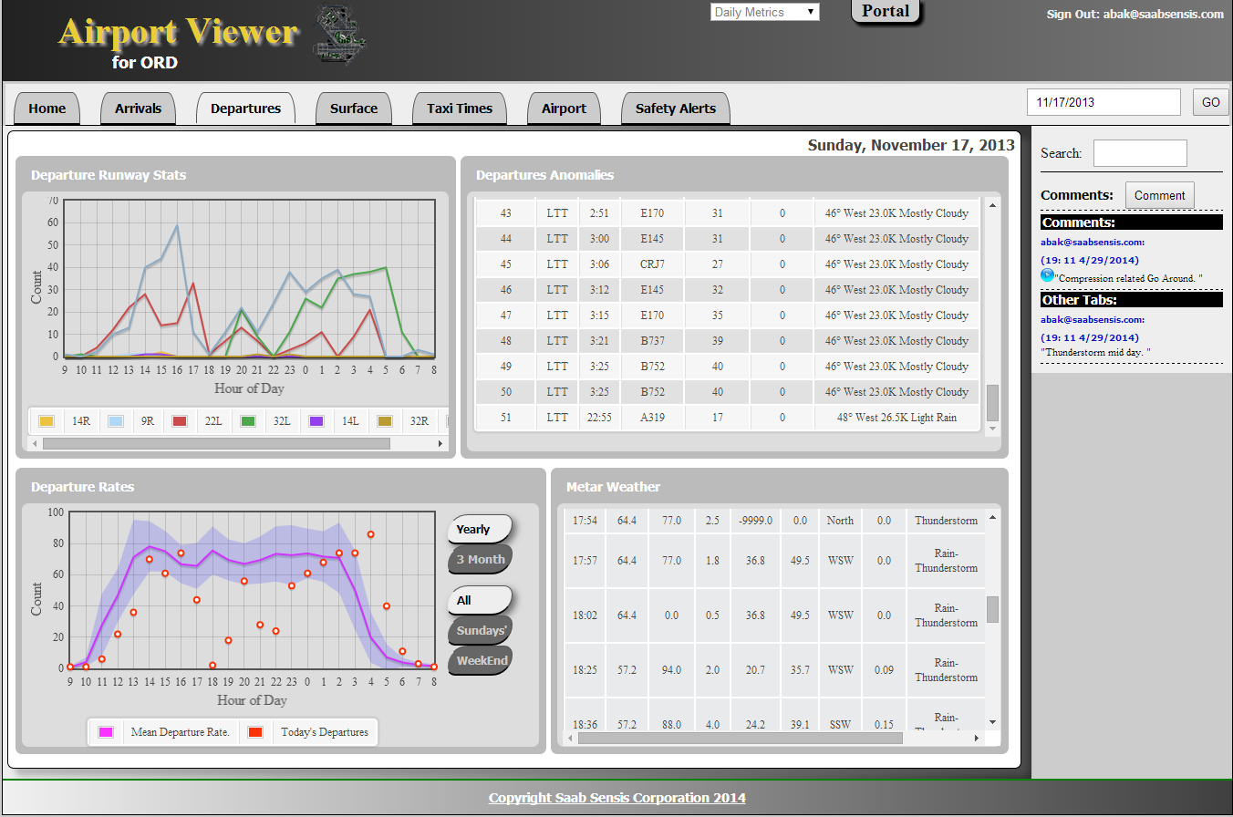
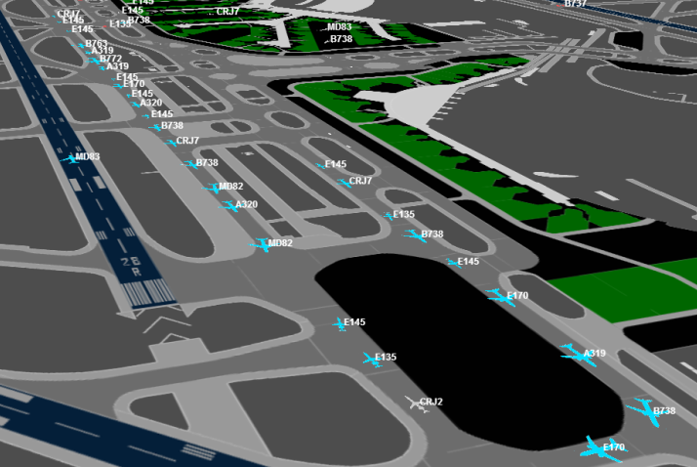
Missed Departure Stats
Numerous “Long Taxi Time” anomalies during the thunderstorm
Clickable comment show playback
Peak runway rate shows massive queue as storm moves in.

Slide 26
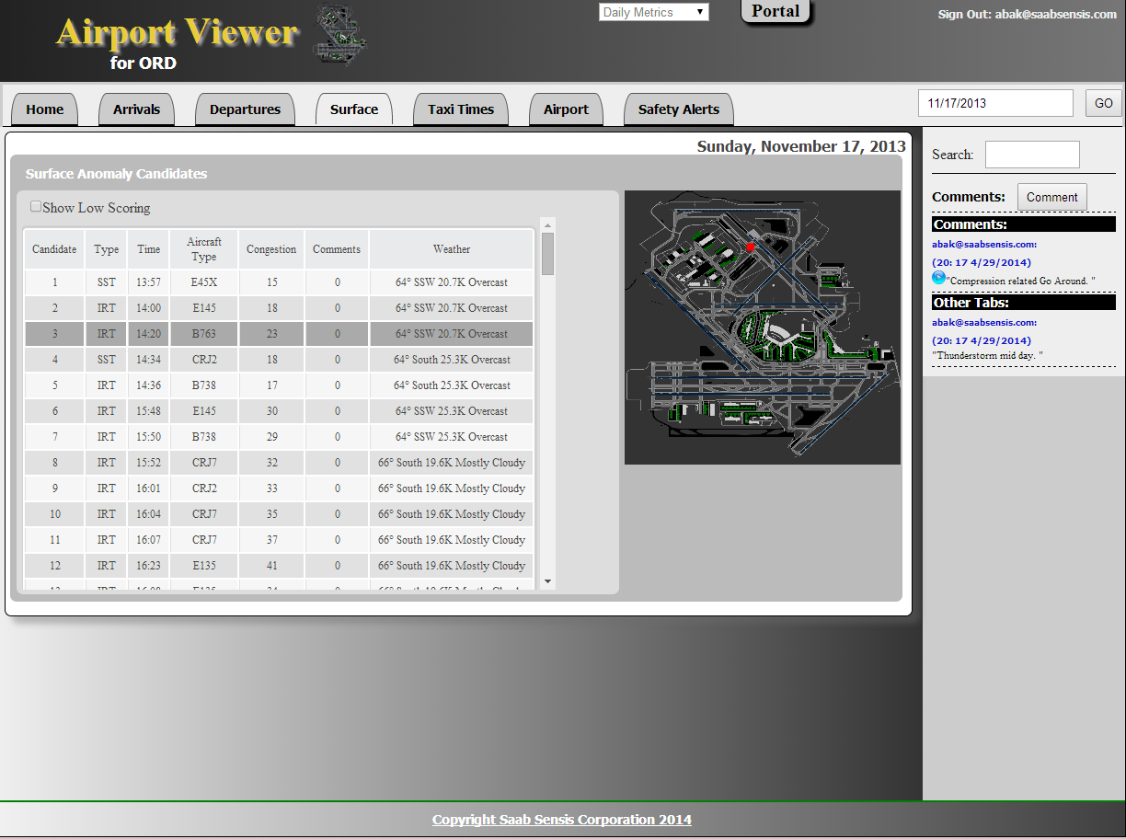
Surface Anomaly Candidates
Surface anomaly candidates including: sudden stops, irregular turns, runway transitions and 9 other types.
Hover over list to show the location, click to playback
High scoring anomaly candidates are shown.

