Slide 1
Integrated Safety Assessment Model (ISAM) Overview
Evaluation of Event Sequence Diagrams and Fault Trees

Slide 2
Agenda
ISAM Overview
Event Sequence Diagrams (ESDs) and Fault Trees (FTs) – Orientation to ESD/FT pictures and documentation
Questions to consider when evaluating ESDs/FTs
ATC-Focused ESDs/FTs - Walk through details and live feedback (as time permits)
Documents to be provided for evaluation

Slide 3
Integrated Safety Assessment Model (ISAM) Overview
FAA System Safety Management (SSMT) Program ➔ System Safety Assessment (SSA) ➔ ISAM
SSMT Mission – Determine:
  How safe is the system today?
  What will be the impact of system change?
SSA Goals
  Support a proactive approach to aviation safety – identify future NextGen related risks
  System-wide access and sharing of aviation safety data and analysis tools
  Capabilities to collaborate with NAS wide data sources
  Collect, analyze and integrate source data
  Development and implementation of integrated safety management systems across the air transportation system

Slide 4
ISAM Overview
SSA Products
NAS-wide risk baseline
  Evaluate the individual and integrated impacts of air traffic, airport and air vehicle systems and operators
Identify and evaluate current and emerging system risks
  Enable analysis of NextGen system-wide safety impact
Enable what-if analysis of NextGen concepts
Report safety and risk assessment projections versus Destination 2025 Goals

Slide 5
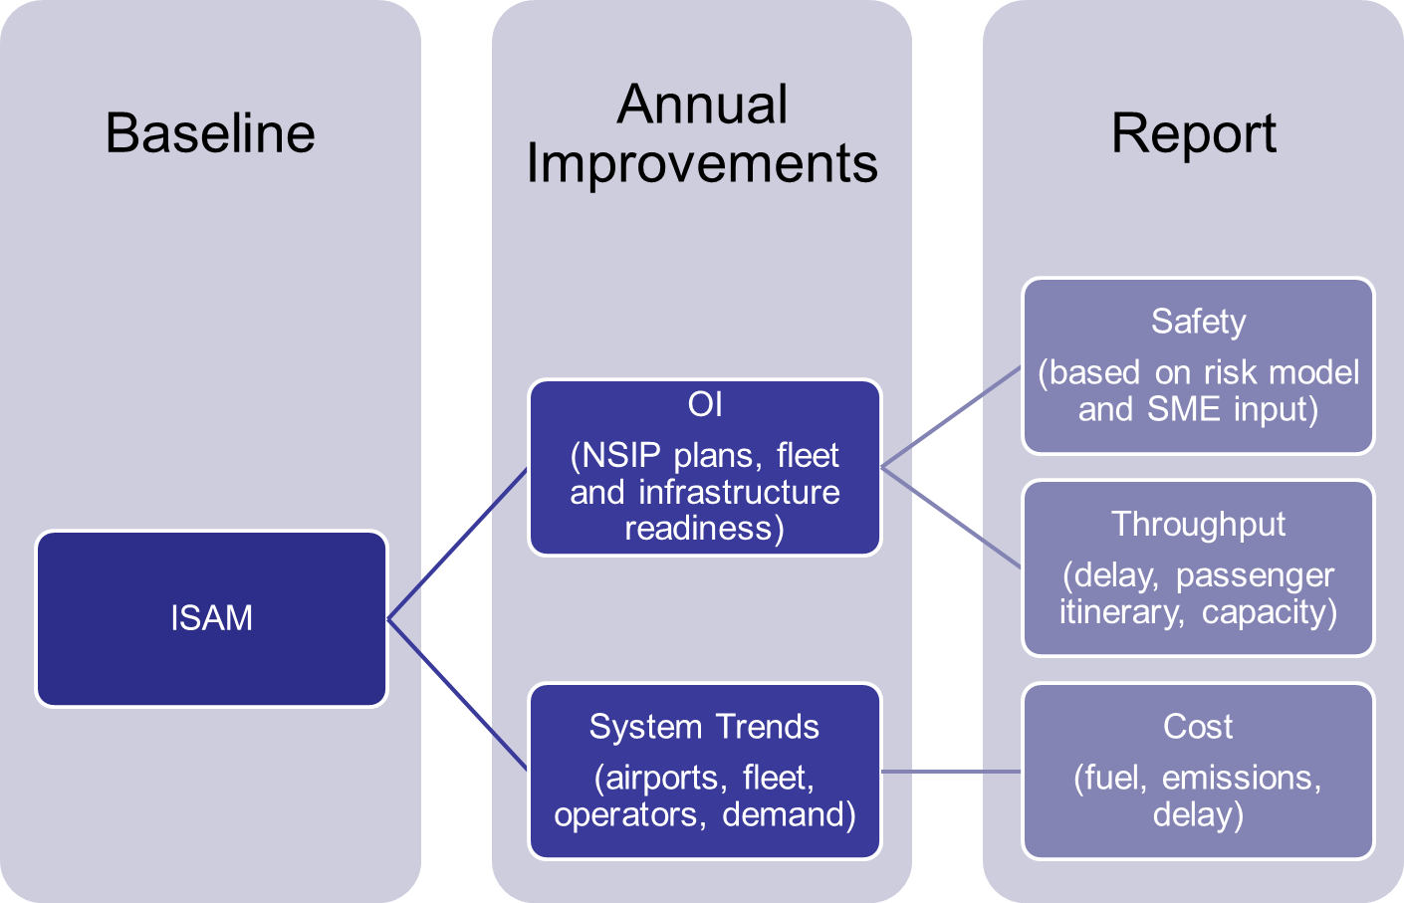
Integrated Safety Assessment Process

Slide 6
ISAM Overview
“Bow-Tie” Model
Event sequence diagrams describe the ‘event’ as it might unfold (time dependent)
Fault Trees describe how the failures that result in each event might occur (not time dependent)
Combined they define outcomes and the precursors to the events
ISAM
Safety
Model
Scoring System
Influence
Model
Hazards
Reporting System

Slide 7
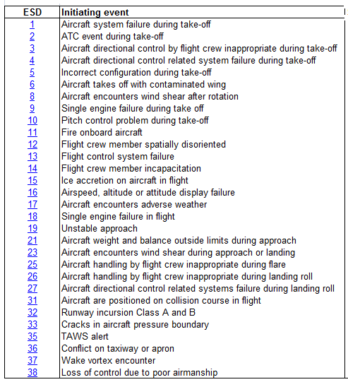
ISAM Safety Model
Integrated pilot and controller impact assessment model of NextGen safety impacts
  Accounts for ATC, aircraft, infrastructure and other system variables
Safety events and barrier failures modeled through Event Sequence Diagrams and Fault Trees.
Causal Model for Air Transport Safety (CATS)
NLR: National Aerospace Laboratory of Netherlands

Slide 8
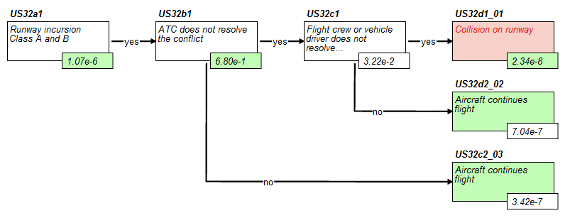
Example Event Sequence Diagram
Initiating Event
End States
Pivotal Events
Runway Incursion Scenario
Conditional Pivotal Event Probabilities
Initiating Event Frequency per Flight
End State Frequencies per Flight

Slide 9
Orientation to ESD/FT pictures and documentation
  ATC-related ESDs/FTs
    US-31: Aircraft are placed on collision course in flight
    US-32: Runway incursion Category A and B
    US-36: Conflict on taxiway or apron
    US-37: Wake vortex encounter
    US-02: ATC event during take-off
    US-19: Unstable approach

Slide 10
Spreadsheet overview – general setup
See Event Sequence Diagram and Fault Tree Pictures Spreadsheet File

Slide 11
Structure of a Particular ESD/FT
    Example
    US-31: Aircraft are placed on collision course in flight

Slide 12
Common elements across ESDs/FTs
Repeated sets of nodes

Slide 13
Questions to consider when evaluating ESDs/FTs
  Based on your experience and expertise, does each ESD/FT reasonably represent the failures in the related accident scenario(s)?
  Based on your experience and expertise, are they expressed correctly - specifically, does the wording/nomenclature used correctly express the actions one may take in the scenario?
  Based on your experience and expertise, does each common element reasonably represent the progress of that element in any/all related accident scenarios?

Slide 14
ATC-Focused ESDs/FTs - Walk through details and live feedback
    US-32: Runway incursion Category A and B
    US-36: Conflict on taxiway or apron
    US-37: Wake vortex encounter
    US-02: ATC event during take-off
    US-19: Unstable approach

Slide 15
Documents to be provided for evaluation
  Spreadsheet linking accident scenarios to ESDs
  Spreadsheet with ESD/FT pictures and data dictionary
  Comment spreadsheet

